Slide 1

Recommendation Systems on the Movies Dataset
A study based on the Recommendation System Algorithms in Machine Learning

Slide 2


CRISP-DM
Stage I - Business understanding
Stage II - Data Understanding
Stage III - Data Preparation
Stage IV - Modeling
Stage V - Evaluation
Stage VI - Deployment

Slide 3

Stage I
Business Understanding

Slide 4

Introduction

Slide 5
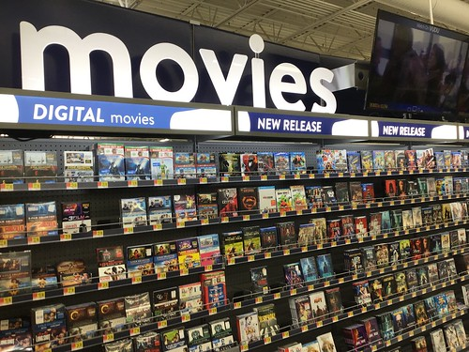
A study based on the Recommendation System Algorithms in Machine Learning:
Content-Based Filtering
Collaborative Filtering
Neural Collaborative Filtering
This Photo by Unknown Author is licensed under CC BY

Slide 6

Objective
To develop a movie recommendation system that enhances user engagement by delivering personalized movie recommendations.
By evaluating recommendation algorithms (content-based, collaborative filtering), the objective is to determine the most effective method for providing high-quality recommendations, with a focus on user satisfaction.

Slide 7
Benefits
Scalable Solution: Implementing a highly efficient recommendation system can provide personalized experiences for millions of users, leading to higher engagement and potential revenue growth.
Research Contribution: By comparing multiple algorithms, the project can contribute to the literature, demonstrating which methods work best for movie recommendation scenarios.
User Engagement: Enhanced user satisfaction through accurate recommendations could lead to increased platform usage and reduced churn.

Slide 8
Timeline
Week 1-2: Data Exploration & Literature Review
Download the dataset and perform Exploratory Data Analysis (EDA).
Week 3-4: Content-Based Filtering Implementation
Implement Content-Based Filtering using techniques like TF-IDF and Cosine Similarity based on movie metadata (genres, tags, etc.).
Week 5-6: Collaborative Filtering Implementation
Implement User-Based and Item-Based Collaborative Filtering using KNN and Matrix Factorization (SVD).
Implement Neural Collaborative Filtering using deep learning frameworks (optional but beneficial for comparison).
Week 7-8: Advanced Techniques (Neural Collaborative Filtering / Hybrid Models)
Compare all implemented algorithms using metrics like RMSE, Precision@K, Recall@K, user satisfaction simulations, and scalability.
Week 9: Comparison of Algorithms
Handle missing values, normalize the data, and prepare it for modeling.
Review research papers on recommendation systems and include key literature in your paper.
Evaluate performance based on user preferences and metrics like Precision, Recall, and F1-Score.
Document findings in the paper, focusing on the strengths and limitations of content-based approaches.
Focus on algorithms available in Surprise or custom implementations.
Compare results using evaluation metrics like RMSE, MAE.
Document findings for both techniques in the research paper.
Experiment with Hybrid Approaches, combining both content-based and collaborative filtering techniques.
Measure performance and scalability across all approaches.
Begin writing the methodology section of the research paper.
Visualize the comparison (e.g., bar plots, tables) for inclusion in the paper.
Discuss the trade-offs (accuracy vs. scalability, cold-start problems) in the paper.
Week 10: Writing the Results & Discussion Sections
Write the Results and Discussion sections of the paper, presenting the findings of the algorithm comparisons.
Discuss the implications of the results for the business use case (e.g., best algorithm for a production environment).
Week 11-12: Finalizing the Paper and Presentation
Revise and finalize all sections of the paper (introduction, literature review, methodology, results, discussion, conclusion).
Prepare a presentation or report summarizing your findings, highlighting the business benefits.

Slide 9
Stage II
Data Understanding

Slide 10

Data
The raw data file consists of 45,466 movies and 24 corresponding features.
Final features: Adult, Budget, id, original_language, popularity, production_companies, production_countries, runtime, spoken_languages, title, vote_average, vote_count

Slide 11
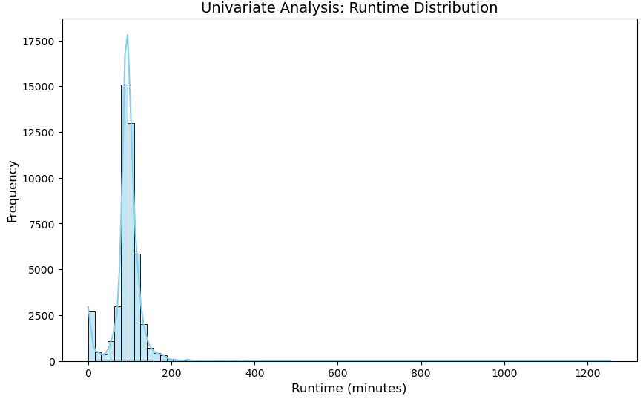
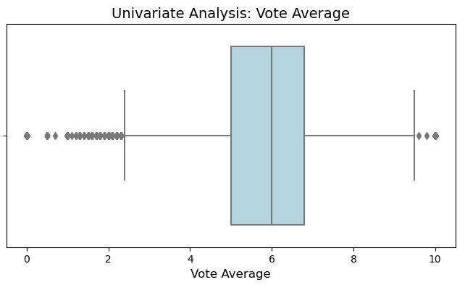
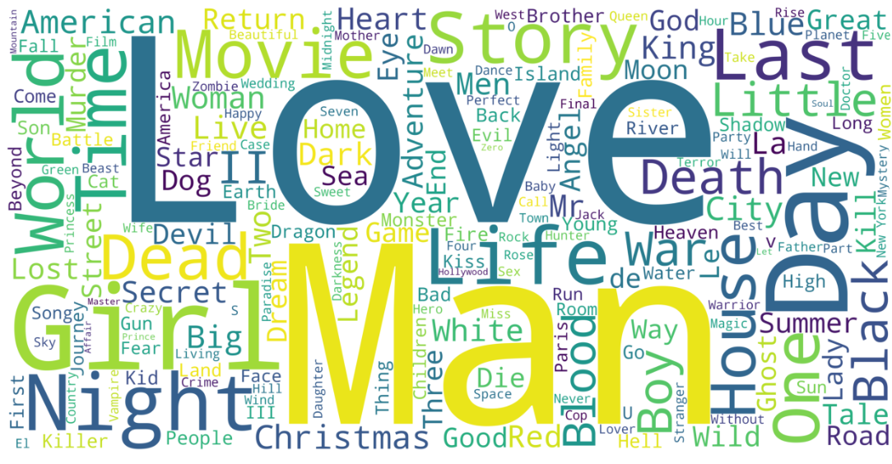
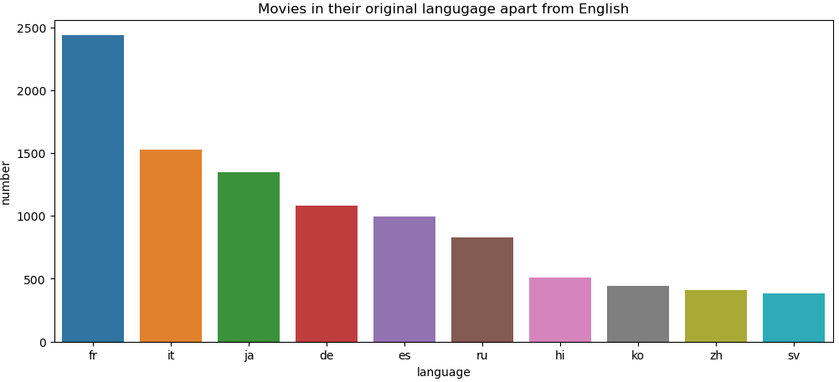

Slide 12
Stage III
Data Preparation

Slide 13
Data Preprocessing
Handling missing values:
The data contained a total of 105,562 cells with missing values.
Columns such as 'homepage','belongs_to_collection’, 'original_title’, 'overview’, 'poster_path’, 'release_date’, 'revenue’, 'status’, 'tagline’, 'video’, 'imdb_id were dropped as they are not needed for the analysis.
The rows which has no movie title were also dropped.
These two steps reduced the missing value count to 268.
Handling Duplicate values:
30 movies were duplicated in the file which were removed.
Data imputation:
11 values for ‘original_language’ were imputed manually
257 null values for the ‘runtime’ column were filled with 0.
Data Transformation:
For content-based filtering, the data for columns such as ‘genres’, ‘production_companies’ , ‘production countries’, ‘spoken_langugages’ needs to be in a list format. The key-value pairs were transformed to a simple list.
After pre-processing, the shape of the final data was (45466, 13)

Slide 14
Stage IV
Modeling

Slide 15
Recommendation System algorithms:
Content Based
Collaborative
Content-based filtering methods are mainly based on the description of an item and a profile of the user’s preferred choices. In content-based filtering, keywords are used to describe the items, whereas a user profile is built to state the type of item this user likes.
Focus is on the category used for filtration such as the genre, actor, director, rating etc
For example, if a user likes to watch movies such as Mission Impossible, then the recommender system recommends movies of the action genre or movies of Tom Cruise.
Evaluation Metrics: Cosine Similarity Matrix
The collaborative filtering method is based on collecting and analyzing information based on behaviors, activities, or user preferences and predicting what they will like based on the similarity with other users.
For example, if X likes Comedy and Thriller, Romance while user Y likes Romance, Comedy, and Sci-fi, they have similar interests. So, there is a high probability that X would like Sci-fi and Y would enjoy Thriller.
One of the main advantages of the collaborative filtering approach is that it can recommend complex items accurately, such as movies, without requiring an understanding of the item itself as it does not depend on machine analyzable content.

Slide 16
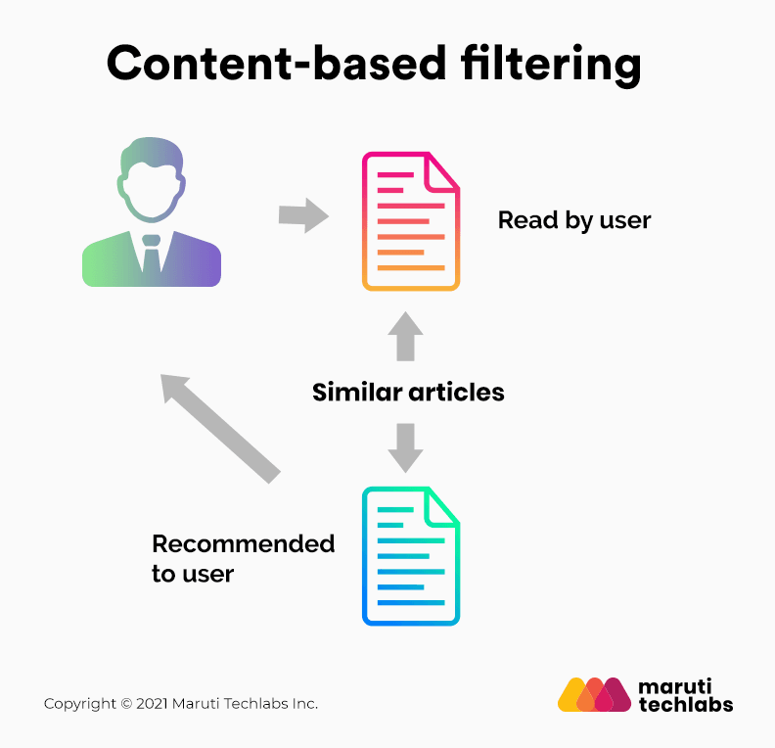
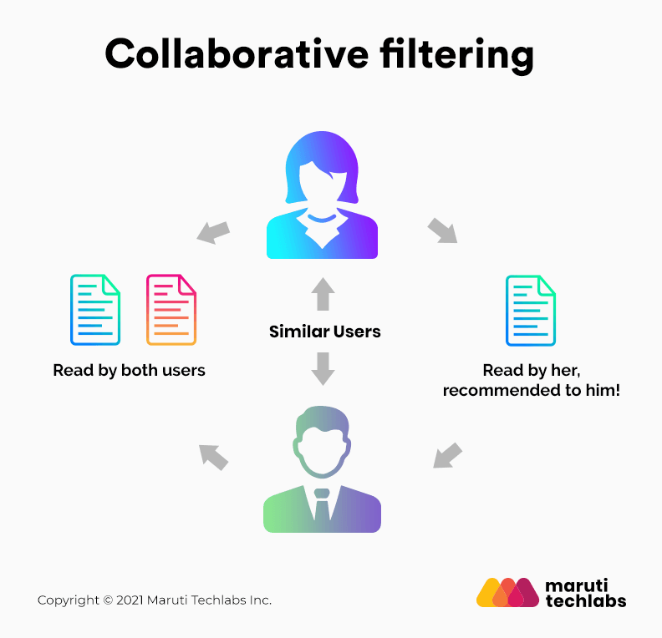
Recommendation System algorithms
Content Based
Collaborative

Slide 17
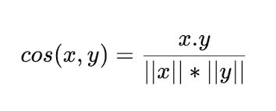
Content Based Filtration
Cosine Similarity Matrix
In this formula:
𝑥: The embedding vector of an item you've liked in the past
𝑦: The embedding vector of another item
(𝑥.𝑦): The dot product between the two vectors
||x||*||y||: The cross product between the two vectors

Slide 18
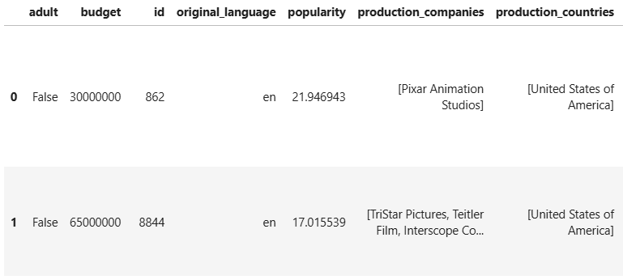
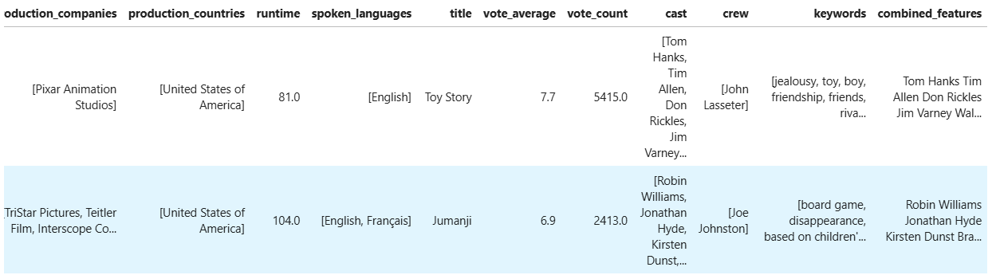
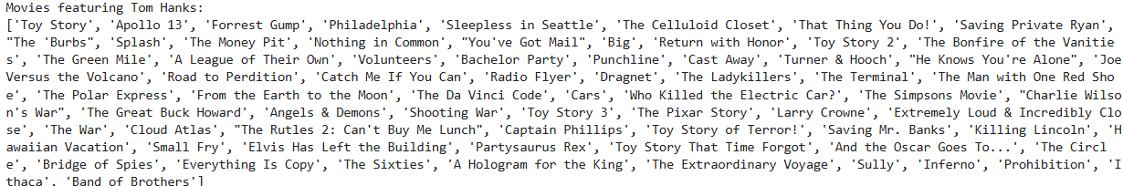
Dataframe:
Movies recommended based on the cast/specific actor:

Slide 19
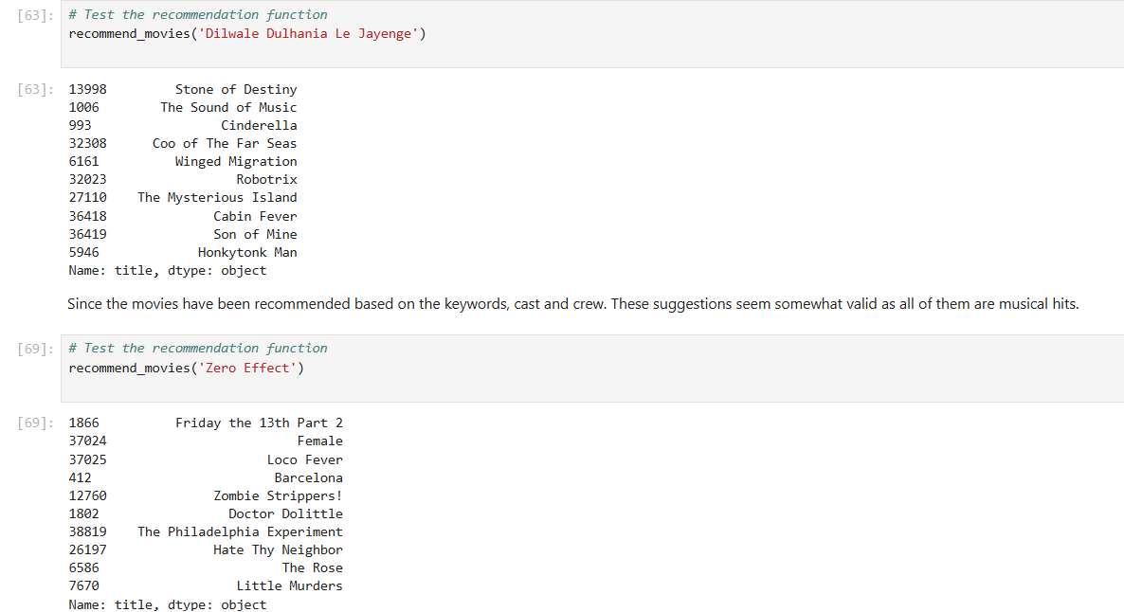
Movies recommended based on the cast, keywords, crew:

Slide 20
Collaborative Recommendation
SVD Algorithm:
Builds user-item matrix
Matrix factorization with SVD
SVD factorizes this user-item matrix into lower-dimensional matrices (typically user factors and item factors) that represent users and items in a latent feature space.
This allows the algorithm to make predictions for missing entries (unseen movies for a user) by estimating the ratings based on patterns observed across the dataset.
Cross-validation: The model was evaluated using RMSE and MAE on multiple folds, which is an excellent metric for understanding how well your model generalizes.
When the model makes predictions on the test set, Surprise calculates how close these predictions are to the actual ratings in the test set using RMSE (Root Mean Square Error) and MAE (Mean Absolute Error).
Made Predictions for Specific Movies:
Ratings for specific user-movie pairs were predicted to see personalized recommendations.
Generated Top-N Recommendations
Create a function to recommend top-N movies for each user based on predicted ratings.
Notes:
RMSE is a measure of the average difference between predicted and actual ratings. A lower RMSE indicates that the model’s predictions are closer to the actual ratings, meaning it’s a more accurate model.
MAE provides a similar measure by averaging the absolute differences between predicted and actual ratings, giving another view of prediction error.

Slide 21
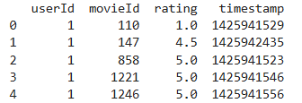
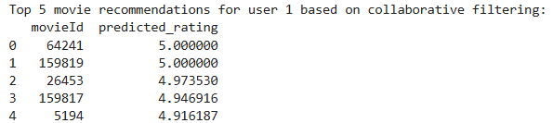
Recommend movies to a user 1 using collaborative filtering alone without relying on specific user pairs.
Dataframe:
Predicted ratings for a movie based on user’s activity:

Slide 22
Neural Collaborative Recommendation
This method uses neural networks to learn latent factors in a user-item interaction matrix. It’s a more complex approach to collaborative filtering.
Neural Collaborative Filtering (NCF): Builds a multi-layer neural network to predict user-item interactions by learning the non-linear relationship between users and items.
Implementation: Used Tensorflow to build a neural network model for collaborative filtering.
Train and Test Data: 90:10 ratio
Algorithm:
Inputs: User Input: A single integer representing the user ID.
Item Input: A single integer representing the item (movie) ID.
Embedding Layers: Each input is passed through an embedding layer:
User Embedding: Maps user IDs to dense vectors of size embedding_size (50 here).
Item Embedding: Maps item IDs to dense vectors of size embedding_size.
Flattening: The embeddings for users and items are flattened into 1D vectors.
Concatenation: The flattened user and item embeddings are concatenated to form a single feature vector.
Fully Connected Layers: A feed-forward neural network processes the concatenated vector:
Dense Layer 1: 128 units, ReLU activation.
Dense Layer 2: 64 units, ReLU activation.
Output Layer: A single neuron outputs the predicted rating (a continuous value).
Loss and Optimization:
Loss: Mean Squared Error (MSE) to minimize the difference between predicted and actual ratings.
Optimizer: Adam for efficient training.
Notes:
RMSE is a measure of the average difference between predicted and actual ratings. A lower RMSE indicates that the model’s predictions are closer to the actual ratings, meaning it’s a more accurate model.
MAE provides a similar measure by averaging the absolute differences between predicted and actual ratings, giving another view of prediction error.

Slide 23
Stage V
Evaluation

Slide 24
Metrics for Evaluation
Root Mean Squared Error (RMSE): Measures how much the predicted ratings deviate from the actual ratings.
Mean Absolute Error (MAE): Measures the average absolute difference between predicted and actual ratings.

Slide 25
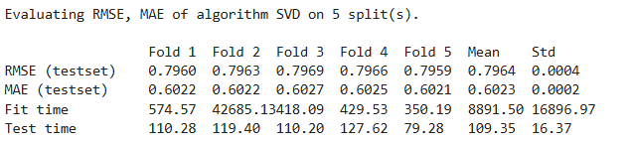
Performance Evaluation of Collaborative Filtering:
The low standard deviation across folds in RMSE and MAE shows that the model is performing consistently, indicating good predictive stability.
Both RMSE and MAE values are below 1 which indicate that the average difference between predicted and actual ratings is low. This shows that the model is more accurate.

Slide 26
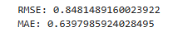
Performance Evaluation of Neural Collaborative Filtering:
Lower RMSE suggests the model predicts ratings closer to the actual values, but it does not directly reflect the proportion of variance explained.
These results indicate an R² value of 0.3664. The RMSE (0.8481) and MAE (0.6398) values align with this R² score, showing the model is not perfect but reasonably accurate in its predictions.
The model is moderately good for providing personalized recommendations but may struggle with edge cases or less popular items.
Specifically useful for long term deployments
Notes:
A lower RMSE is better. Depending on the rating scale (e.g., 1–5), this value suggests reasonably good performance, but there may still be room for improvement.

Slide 27
Stage VI
Deployment

Slide 28
Deployment and Challenges:
Recommendation systems improve user satisfaction by making it easier to discover relevant content, reduce churn rates for platforms, and drive revenue through enhanced engagement and retention.
This recommendation system with an advanced training has future scope for deployment on platforms where users can input their preferences to get tailored suggestions.
Linkedin search recommendation
Streaming services
Media and Entertainment platforms
Ticket booking platforms: Suggest movies currently playing in theaters based on past bookings or preferences.
Online learning platforms(Udemy, Coursera): Suggest educational films or documentaries related to courses or interests.
Limitations:
The project uses a limited dataset and simplified models due to resource constraints.

Slide 29
Thank you
Shivani Battu
sbattu1@kent.edu

